Slide 1
F
N
F_{f}
Fsinθ
Fcosθ
θ
F

Slide 2
α
Robots
Mean Position
Covariance
Desired Cov A
Desired Cov B
Goal Regions
Goal 1
B
A
Goal 2

Slide 4
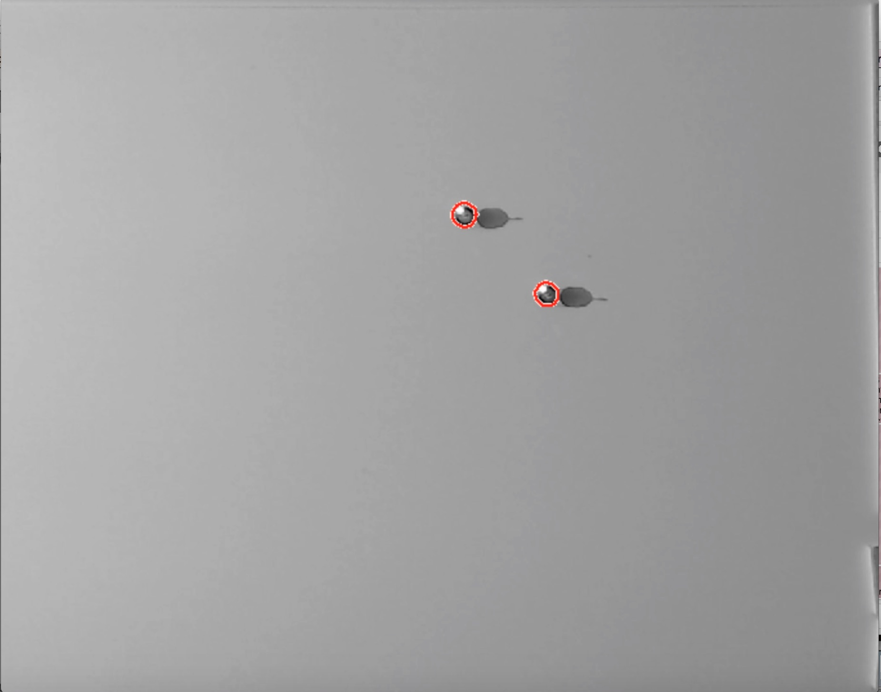

Slide 5
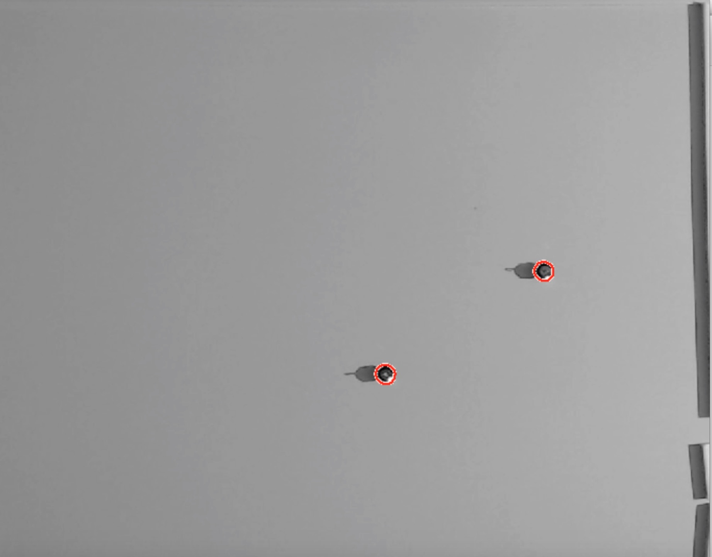
Robot
Bottom Path
Top Path
Goal Positions

Slide 6
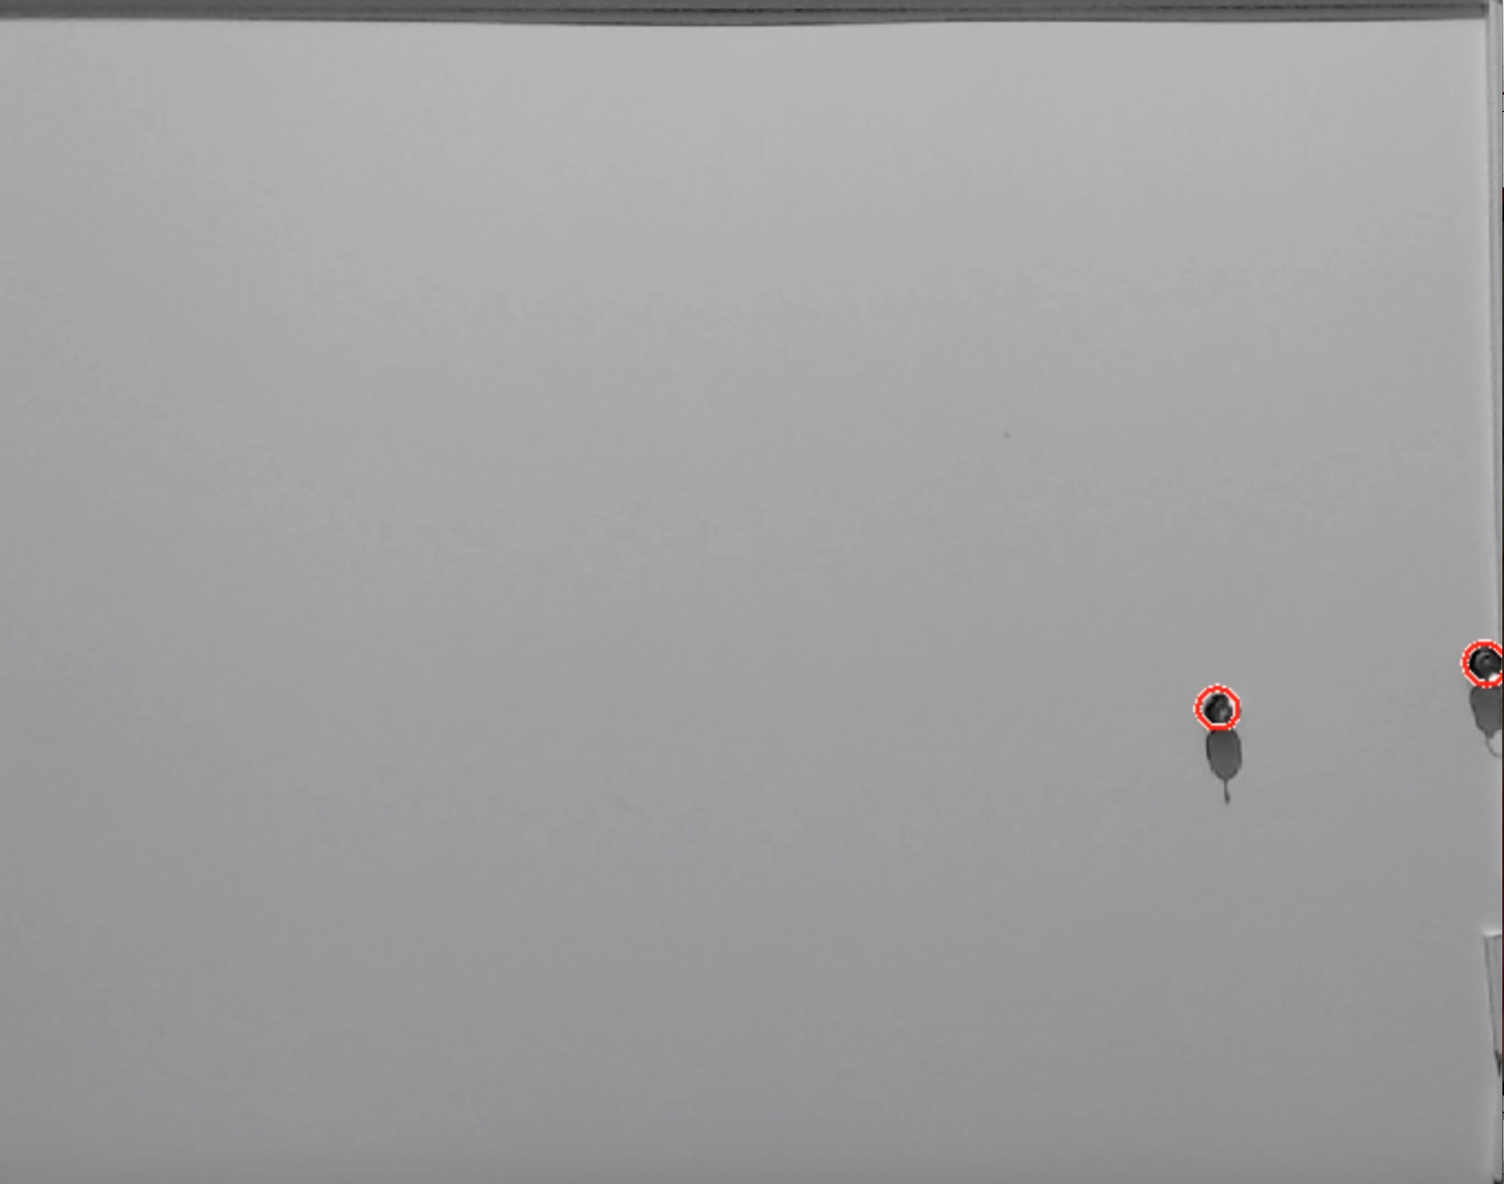

Slide 7
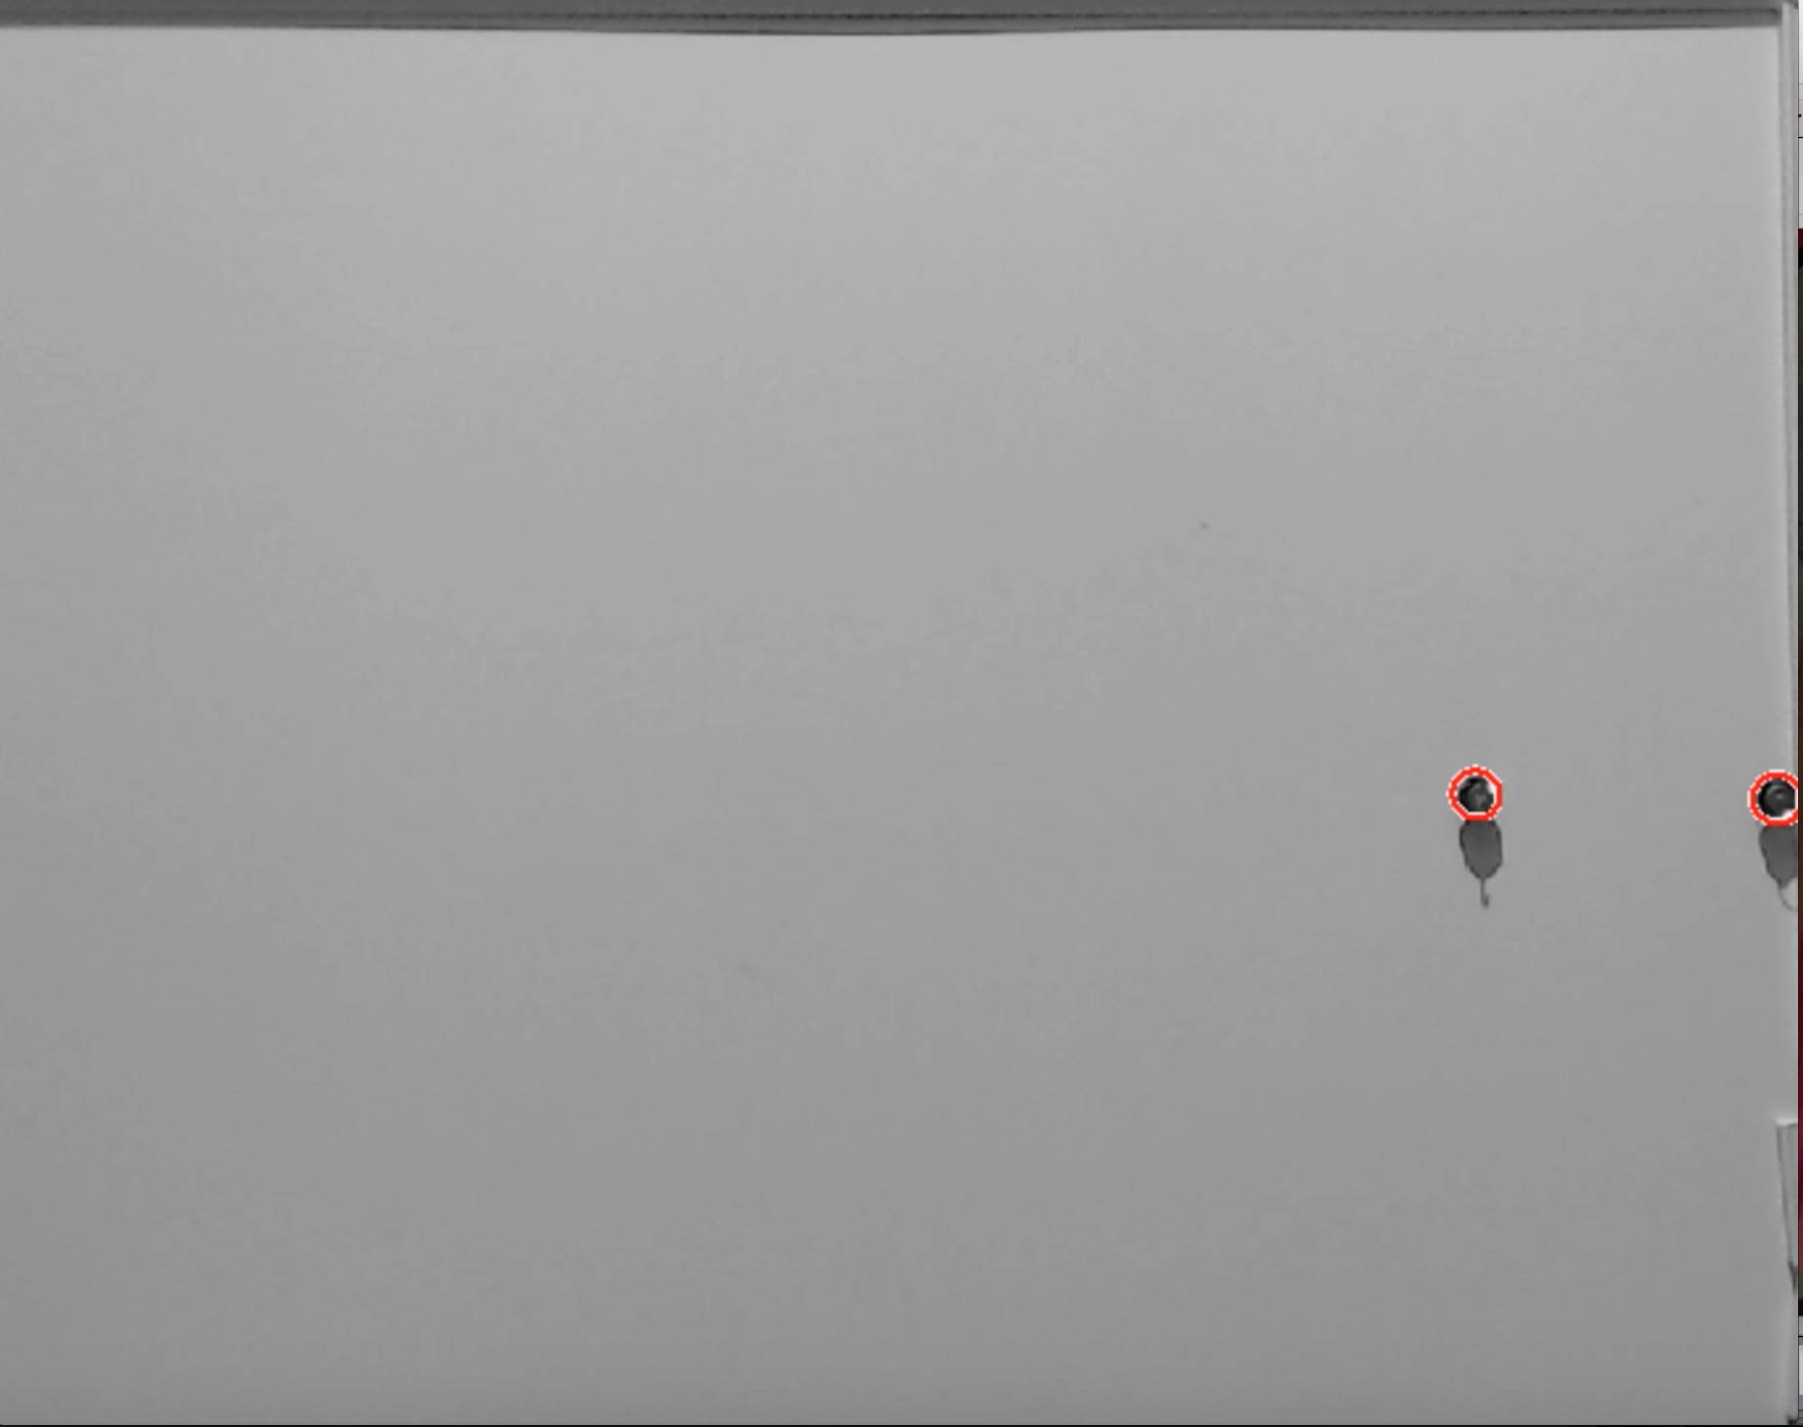

Slide 8
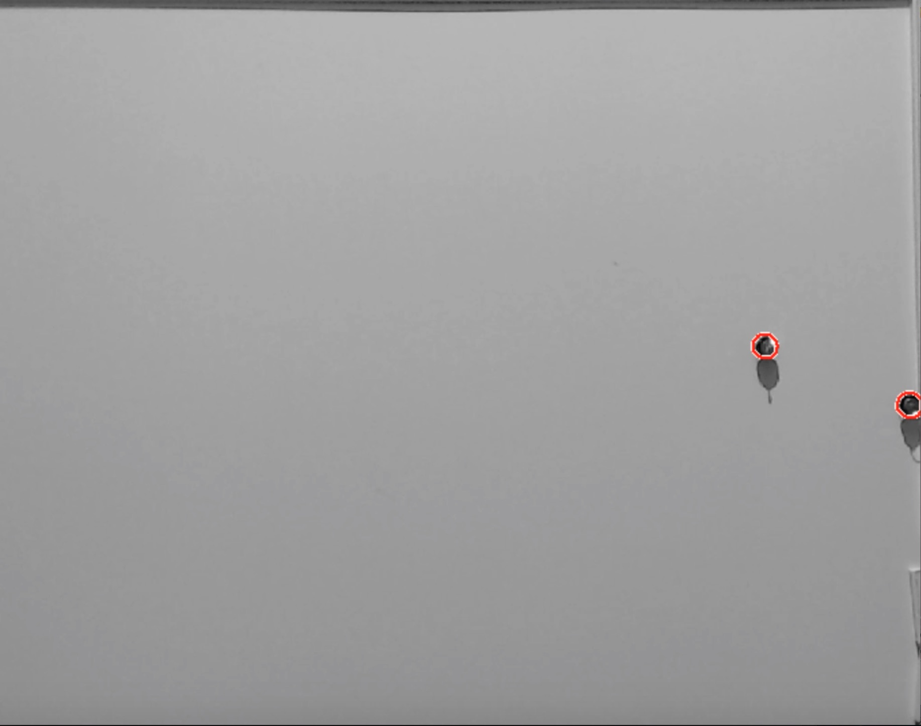

Slide 10
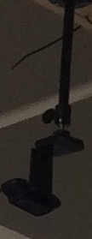
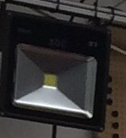
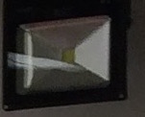
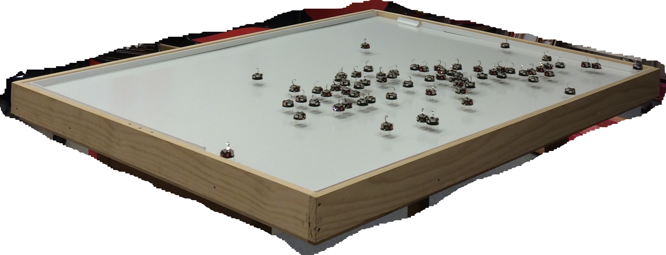
Webcam
1.5 m
30W LED Light
30W LED Light
Table of the robots
Robots
1.2 m
1.5 m

Slide 11
